Slide 1

Rationale
Introduction to Windows Store App Development Using HTML5 and JavaScript
Computer science is a field of study that deals with solving a variety of problems by using computers.
  To solve a given problem by using computers, you need to design an algorithm for it.
Multiple algorithms can be designed to solve a particular problem.
An algorithm that provides the maximum efficiency should be used for solving the problem.
  The efficiency of an algorithm can be improved by using an appropriate data structure.
Data structures help in creating programs that are simple, reusable, and easy to maintain.
This module will enable a learner to select and implement an appropriate data structure and algorithm to solve a given programming problem.

Slide 2
Objectives
  In this session, you will learn to:
  Manage authentication in an app
Notes:
2

Slide 3
Managing Authentication in an App
  Authentication helps in determining whether the user is an authenticated user or not based on the user name and password provided by the user.
  The user name and password provided by the user are referred to as user credentials.
To accept user credentials:
You can use a custom UI that you develop on your own.
You can use the Credential Picker UI, which provides a default interface for accepting user credentials.
Notes:
3

Slide 4
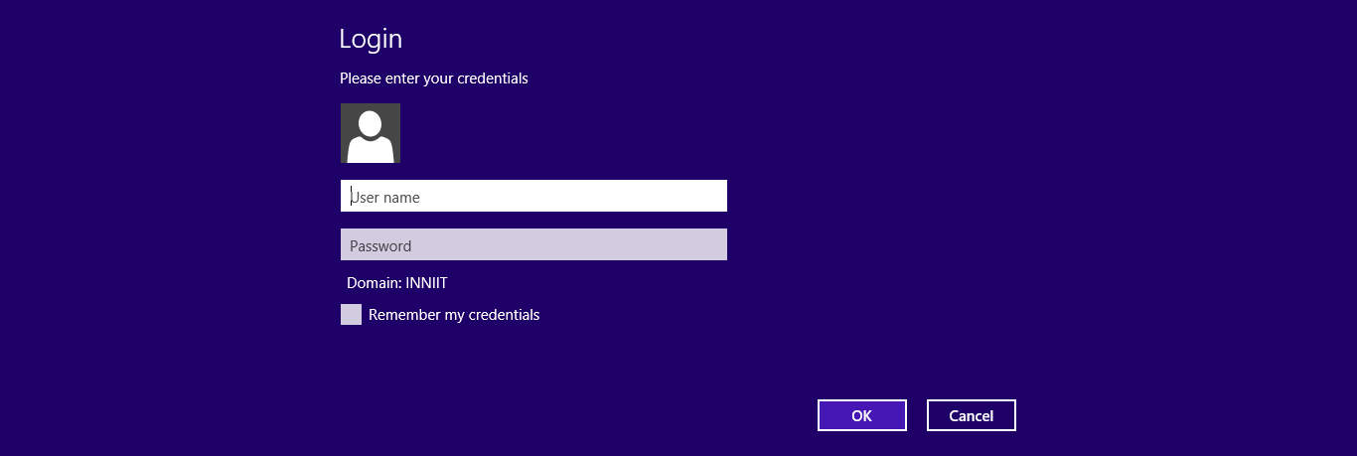


Using the Credential Picker UI
  The Credential Picker UI collects the credentials from the users.
  The Credential Picker UI appears, as shown in the following figure.

Slide 5
Using the Credential Picker UI (Contd.)
To create the Credential Picker UI:
The CredentialPicker class defined in the Windows.Security.Credentials.UI namespace is used.
To display the Credential Picker UI:
The pickAsync() method of the CredentialPicker class is called.

Slide 6
Using the Credential Picker UI (Contd.)
  The pickAsync() method returns an instance of the CredentialPickerResults class that will contain the credentials and options provided by the user.
  The commonly-used properties of the CredentialPickerResults class are listed in the following table.
Method | Description
credentialDomainName | Is used to retrieve the domain name.
credentialPassword | Is used to retrieve the password provided by the user.
credentialUserName | Is used to retrieve the user name provided by the user.
credentialSaved | Is used to check the status whether the credential provided by the user is successfully saved by the credential manager or not.
credentialSaveOption | Is used to check whether the user has selected the checkbox for saving the credentials or not.

Slide 7
Just a Minute
  Identify the correct code snippet for the pickAsync() method.
    1. credentialPicker.pickAsync(targetName, message,
    caption)
    2. credentialPicker.pickAsync(message, caption,
    targetName)
    3. credentialPicker.pickAsync(targetName, caption,
    message)

Slide 8
Just a Minute (Contd.)
  Solution:
    1. credentialPicker.pickAsync(targetName, message,
    caption)

Slide 9
Using the Credential Picker UI (Contd.)
Let us look at an example, which creates and displays the Credential Picker UI

Slide 10
Storing and Retrieving Credentials
  When a user logs on to a secured app, a dialog box is displayed to the user for accepting the credentials and specify whether to save the credentials or not.
  If the user decides to save the credentials, the user name and password provided by the user are stored in the credential locker.
  The credentials stored in the credential locker are managed by using the Credential Manager.
  The Credential Manager keeps track of the user name, password, and other information provided by the user.

Slide 11
Storing and Retrieving Credentials (Contd.)
  To store credentials:
Check whether the user has opted to save the credentials or not.
Create an instance of the PasswordVault class.
Create an instance of the PasswordCredential class.
Add credentials in the credential locker.

Slide 12
Just a Minute
  The __________ class represents a credential locker.
    1. PasswordVault
    2. PasswordCredential

Slide 13
Just a Minute (Contd.)
  Solution:
    1. PasswordVault

Slide 14
Storing and Retrieving Credentials (Contd.)
  To retrieve credentials:
Create an instance of the PasswordVault class.
Invoke the findAllByResource() method.
Let us look at an example, which stores and retrieves credentials

Slide 15
Summary
  In this session, you learned that:
  The Credential Picker UI provides a default interface for accepting user credentials.
  The credentials provided by the user are stored in the credential locker.
  The Credential Manager keeps the track of the user name, password, and other information provided by the user.
Notes:
15

Slide 16

Q&A

